Slide 1
HCI PROJECT
“Smart Subtitles for Vocabulary Learning”
TEAM NAME: HCI_0104_1802_1951_2129 | Mithul B V
 | Ravichandu S
 | B K Mohammad Kamran
 | Mayank Keshan

Slide 2
ABSTRACT
Language learners often use subtitled videos to help them learn. However, standard subtitles are geared more towards comprehension than vocabulary learning, as translations are nonliteral and are provided only for phrases, not vocabulary
Smart Subtitles can be automatically generated from common video sources such as subtitled DVDs. They provide features such as vocabulary definitions on hover, and dialog-based video navigation

Slide 3
INTRODUCTION
Students studying foreign languages often wish to enjoy authentic foreign-language video content. For example, many students cite a desire to be able to watch anime in its original form as their motivation for starting to study Japanese.
However, standard presentations of videos do not provide good support for language learners. For example, if a learner were watching anime, and did not recognize a word in the dialog, the learner would normally have to listen carefully to the word, pause the video, and look the word up in a dictionary

Slide 4
There are other ways to show language learners videos to help them learn, such as dual subtitles, which simultaneously display subtitles in both the viewer’s native language and the language of the video. However, we believe we can do even better at teaching vocabulary than dual subtitles by introducing interactive features into the video player to support common language learning tasks
Smart Subtitles includes features to help learners learn vocabulary and navigate videos. It prominently displays a transcript of the foreign-language dialog, to focus learners’ attention on the foreign language. Learners can view definitions for words in the video by hovering over them. Learners can review the current and previous lines of dialog by clicking on them to replay the video.

Slide 5
PURPOSE
An interactive video viewer with features to help language learners learn vocabulary and navigate videos.
A system for extracting subtitles from various sources, including hard-subtitled video where the subtitles are baked into the video stream.
A system to automatically annotate subtitles with word definitions and romanizations to display to language learners.
A pilot study that suggests that Smart Subtitles improves intermediate-level learners’ short-term vocabulary learning relative to dual subtitles, with no changes in viewing times, enjoyment, or comprehension.

Slide 6
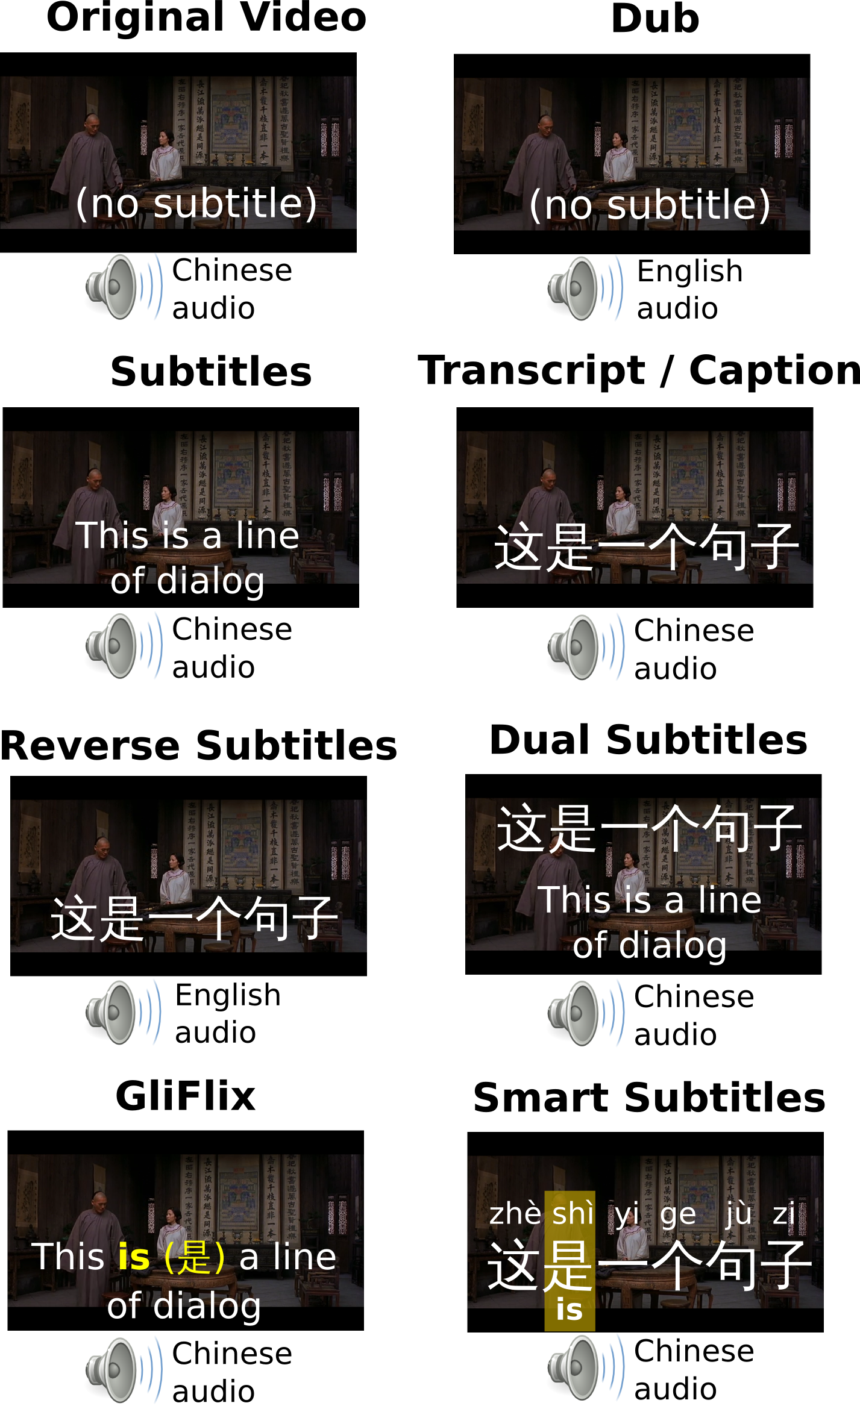
RELATED WORK Video has several advantages as a medium for language learning. By presenting vocabulary in the context of a natural dialog, as opposed to isolated drills, video promotes contextualized learning, helping learners understand how vocabulary is actually used in the language . In classroom contexts, students are sometimes given advance organizers, supplemental materials explaining vocabulary and concepts that appear in the video, which help combine the benefits of drill-based learning with the context provided by videos

Slide 7
Presenting Videos to Language Learners
In addition to subtitles, there exist other techniques to aid language learning while watching videos, described below.
With a transcript, also known as a caption, the video is shown along with the text in the language of the audio, which in this case is the foreign language. Transcripts are generally used to assist hearing-impaired viewers. However, they can also be beneficial to language learners for comprehension, particularly if they have better reading ability than listening comprehension ability. However, for learners with only basic reading abilities, using only a transcript can lead to decreased comprehension compared to subtitles

Slide 8
SMART SUBTITLES INTERFACE
A video viewing tool, Smart Subtitles, which provides language learners with interactive features to help them learn vocabulary. Smart Subtitles supports features for learning vocabulary and navigating dialogs. Smart Subtitles can be used by English speakers to view videos in Chinese, Japanese, French, German, and Spanish.
Smart Subtitles is an interactive web application that runs in the user’s browser. The user simply provides it with a video and a caption, from either a streaming service or from the local filesystem, and the interactive video player will start once it finishes automatically generating annotations.

Slide 9
Vocabulary Learning Features
To reduce the effort required for vocabulary lookups, our interface allows the user to hover over words in the dialog to show their definitions
Sometimes, word-level translations are not enough for the learner to comprehend the current line of dialog. To address these cases, Smart Subtitles includes a button that shows learners a translation for the currently displayed line of dialog when pressed
Because poor ability to read Chinese characters can limit the usefulness of Chinese and Japanese captions, the interface shows learners how to pronounce Chinese characters. For Chinese, it shows pinyin, the standard romanization system for Chinese. For Japanese, it shows hiragana, the Japanese phonetic writing system. These writing systems are taught to learners in first-semester Chinese and Japanese classes.

Slide 10
IMPLEMENTATION
Smart Subtitles faces several implementation challenges, such as extracting subtitles from various video, listing vocabulary words, and determining their definitions and romanizations.
Smart Subtitles are automatically generated from captions with the assistance of dictionaries and machine translation. Our implantation currently supports Chinese, Japanese, French, German, and Spanish, but support for other languages can easily be added if a bilingual dictionary is available.

Slide 11
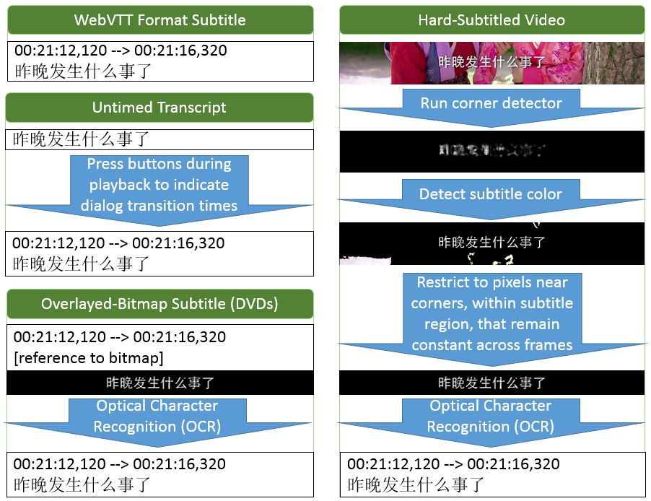
The Smart Subtitles system is implemented as 2 main parts: a system that extract subtitles and captions from videos,
Extracting Subtitles from Videos
Our system takes digital text captions in either the SubRip or Web Video Text Tracks (WebVTT) formats as input. These are plain-text formats that specify the textual lines of dialog, along with their respective display times. Users can download these from various online services, such as Universal Subtitles

Slide 12
Listing Vocabulary Words in a Line of Dialog
The subtitles generated by our subtitle extractor provide us with the text of each line of dialog. For many languages, going from each line of dialog to the list of words it includes is fairly simple, since words are delimited by spaces and punctuation. For European languages supported by Smart Subtitles (French, Spanish, and German), the Smart Subtitles system lists vocabulary words in each line of dialog using the tokenizer included in the Natural Language Toolkit
A particular issue which occurs with Chinese and Japanese is that the boundaries between words are not indicated in writing. To determine what words are present in each line of dialog in these languages, we instead use statistical word segmenters. We use the Stanford Word Segmenter for Chinese, and JUMAN for Japanese.

Slide 13
Getting Translations for Full Lines of Dialog Translations for full lines of dialog are obtained from a subtitle track in the English, if it was provided to the program. For example, if we gave Smart Subtitles a Chinese-language DVD that contained both English and Chinese subtitles, then it would extract translations for each line of dialog from the English subtitles. Alternatively, if only a transcript was provided, and not a subtitle in the viewer’s native language, it relies on a machine translation service to obtain translations. Either Microsoft’s or Google’s translation service can be used.

Slide 14
USER STUDY We evaluate Smart Subtitles with a within-subjects user study that compares the amount of vocabulary learned when watching videos with our system, to the amount of vocabulary learned when using dual English-Chinese subtitles. We wish to compare the effectiveness of our system in teaching vocabulary to dual subtitles, which are believed to be among the best ways to learn vocabulary while viewing videos

Slide 15
Materials We used a pair of 5-minute video clips, both taken from the drama. One clip is the first 5 minutes of the first episode of the drama, while the second clip is the next 5 minutes of the drama. The Chinese and English subtitles were automatically extracted from a DVD using our OCR-based subtitle extraction system.

Slide 16
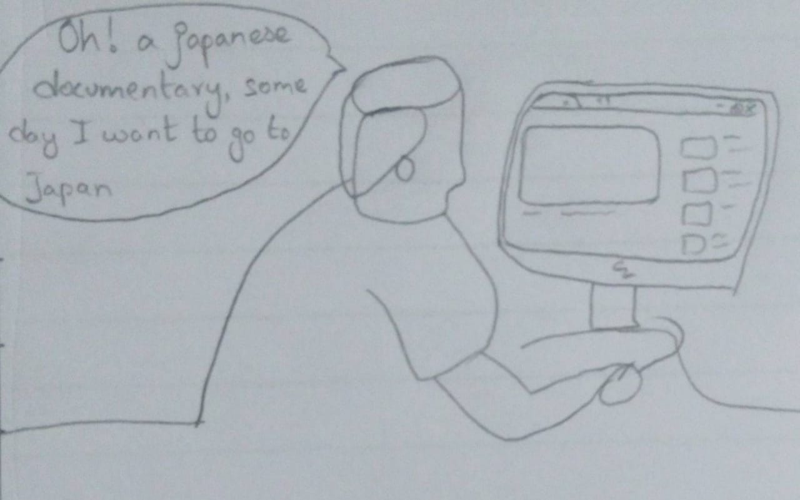
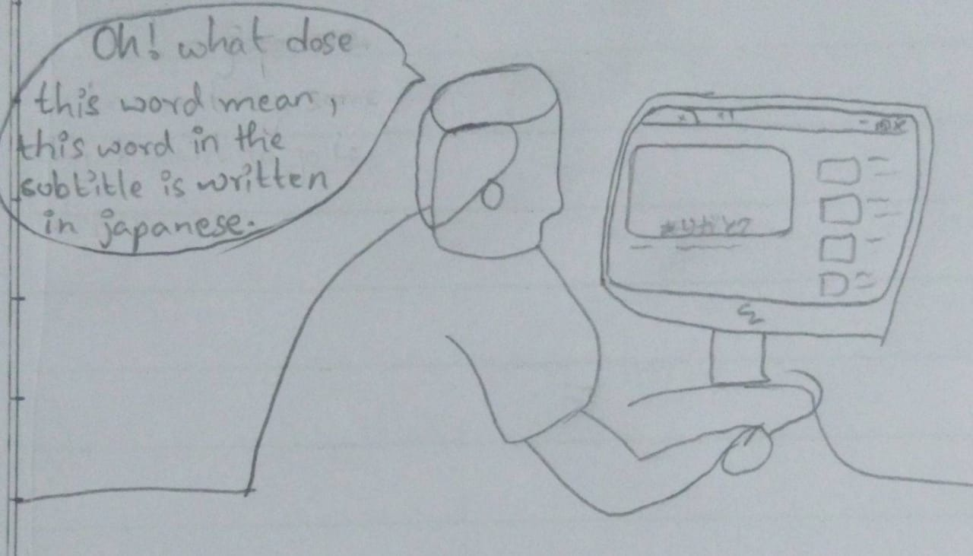
STORY BOARDING

Slide 17
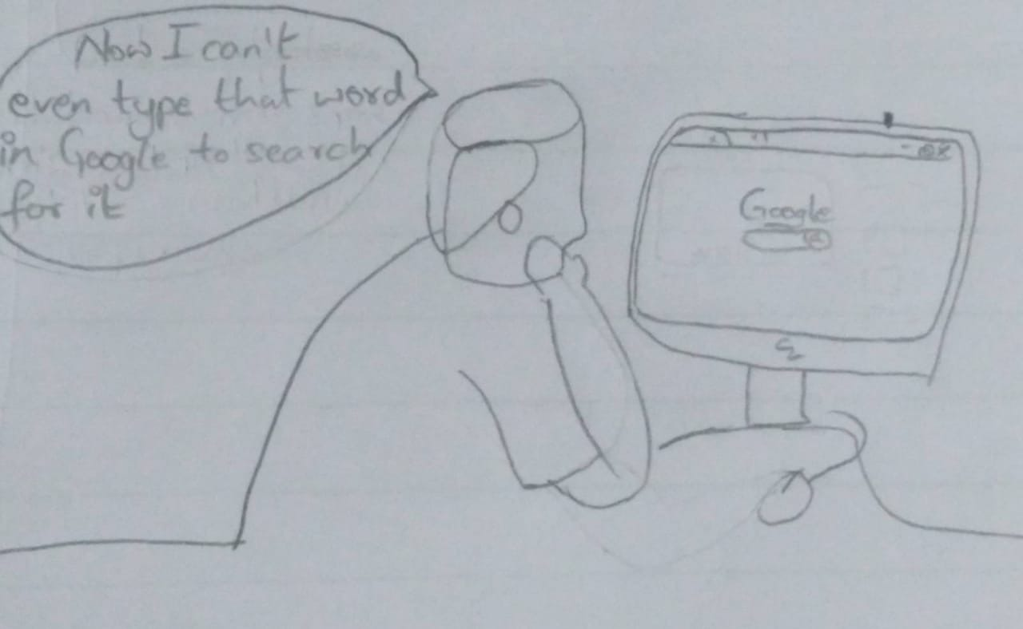
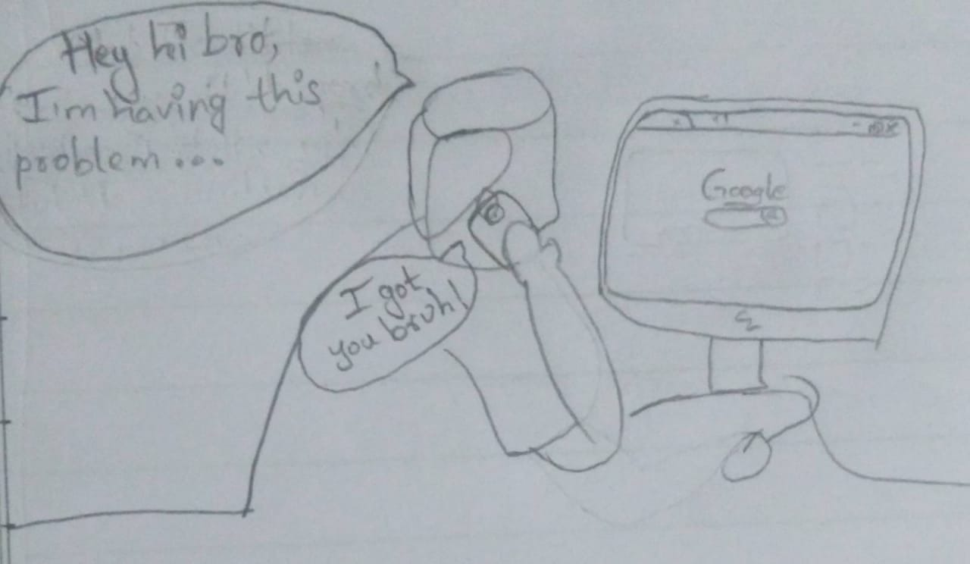
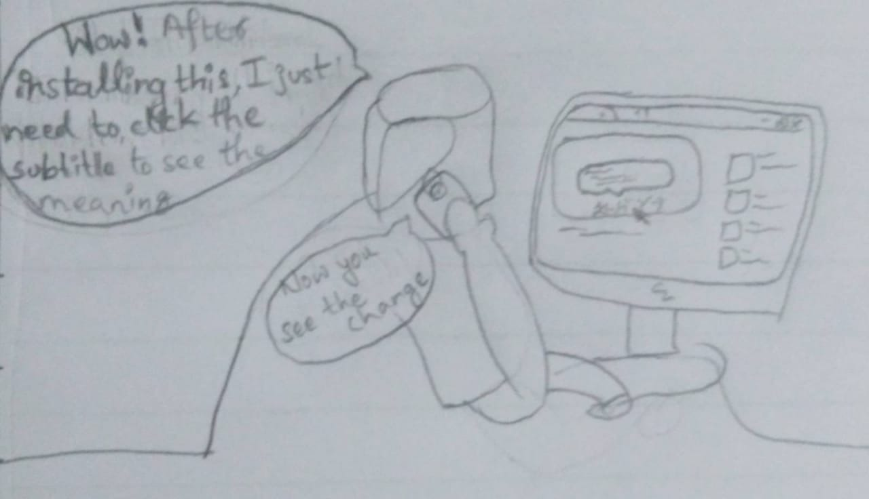

Slide 18
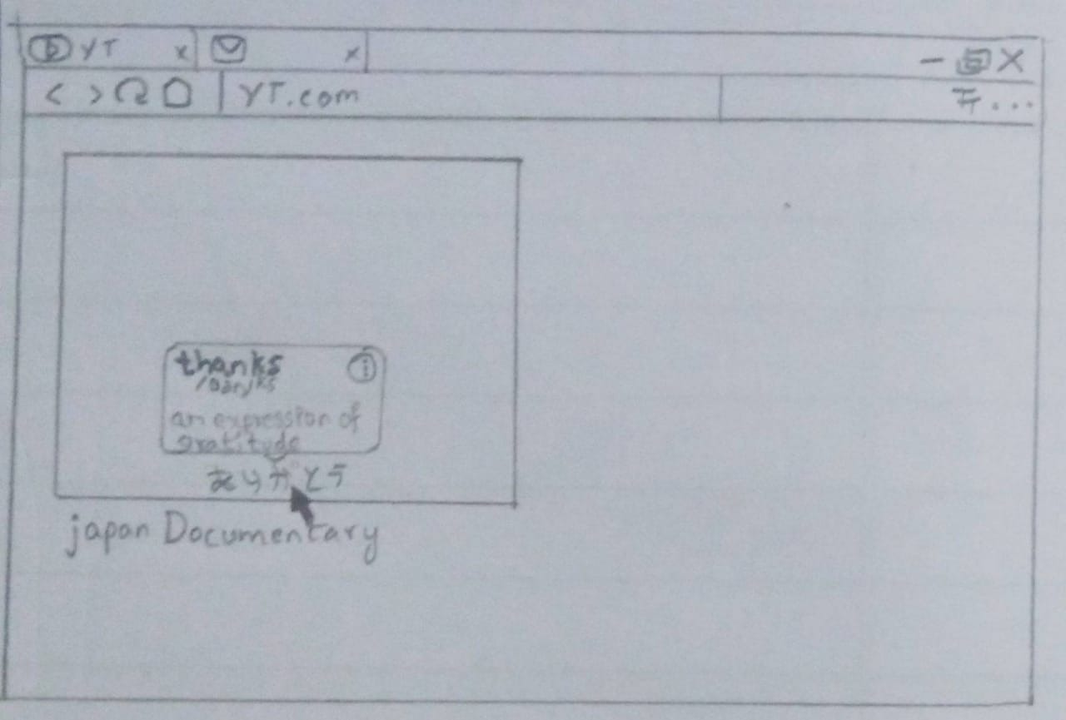
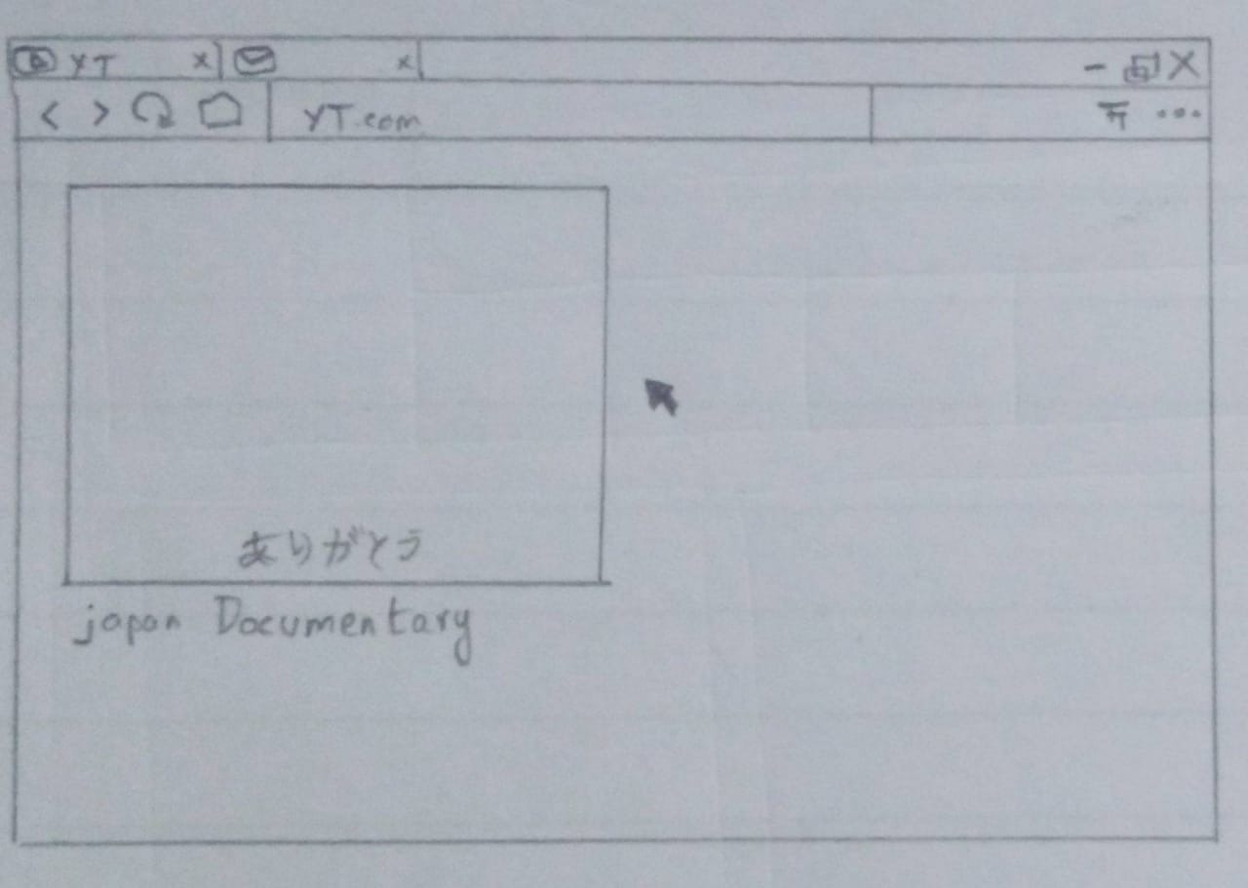
LOW FIDELITY PROTOTYPE

Slide 19
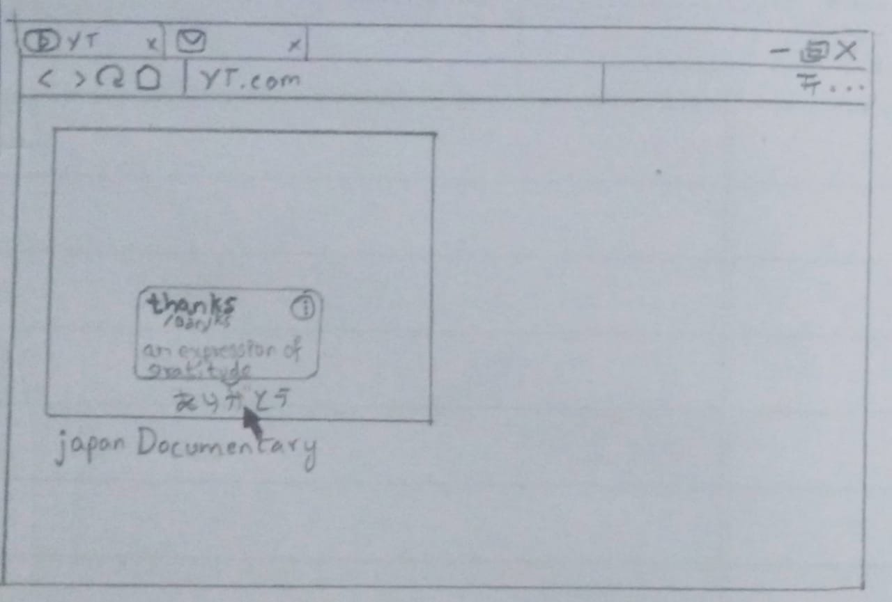
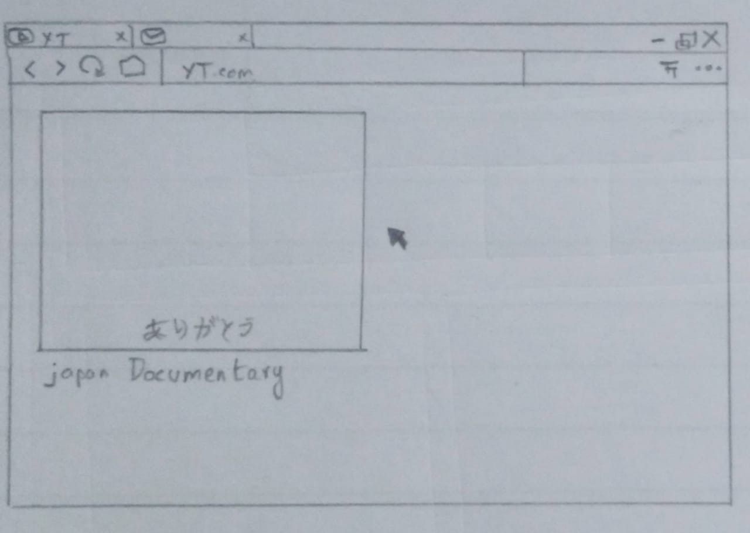
HIGH FIDELITY PROTOTYPE

Slide 20
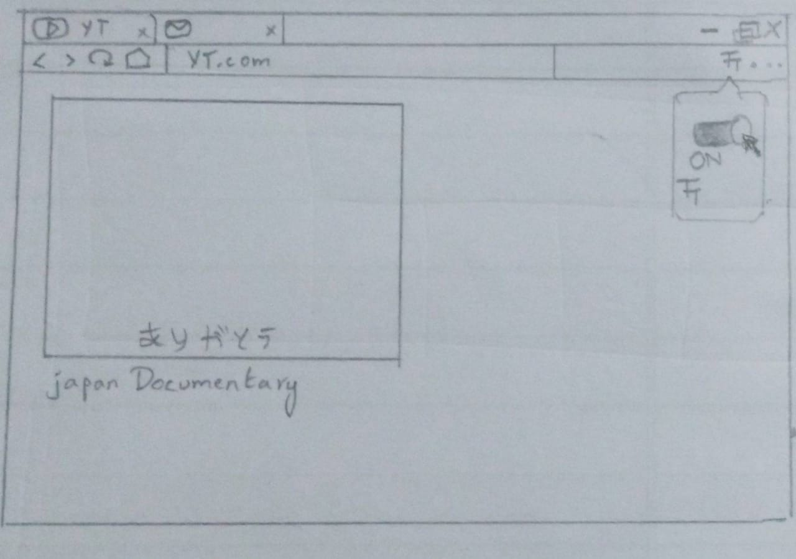
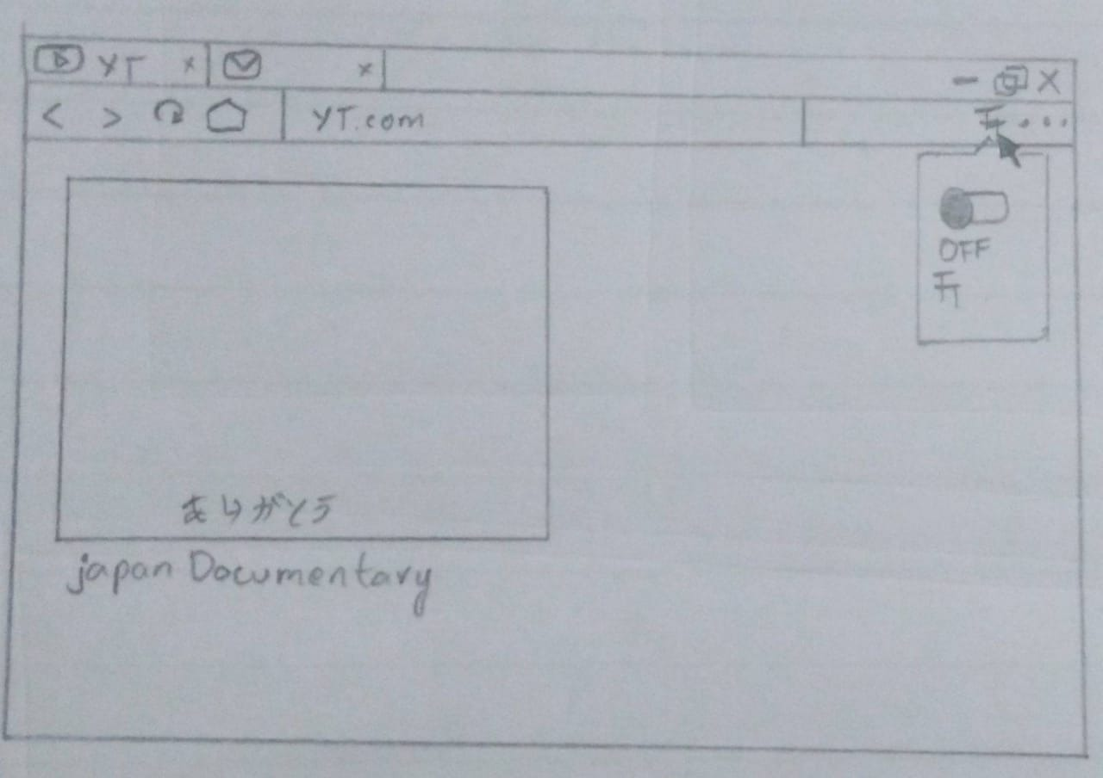

Slide 21
Heuristic evaluation
User freedom and control:
The UI is completely under the user's control if he ticked the box by mistake he can easily untick it and continue watching normally
Consistency and standards:
The design is made it such a way that it doesn't show conspiracy with other features available for the user. The application is just made for people who want to learn the language along with watching the video and the standards are maintained so that it can compete with dual subtitles

Slide 22
Error prevention:
The prevention of errors is the basic attribute of a good UI design. All the error prone conditions are eliminated but the user may find some difficulty when he hovers because a single word may have different meanings
Recognition rather then recall:
As the UI is simple the user need not remember alot of options available. As the tick box is clearly visible. So it won't be difficult for the user to use it

Slide 23
Flexibility and efficiency of use:
The design is very simple as it's just an on and off feature. But the user will still be able to navigate other inbuilt features available. The system is efficient and doesn't need any expertise
Help and documentation:
The user will get a help section where he can just understand where he can find the hovering feature to be ticked.

Slide 24
Help users recognize, diagnose, and recover from errors:
Whenever there is an error it should be indicated in normal language and a suitable solution if possible. As per the error occurrence the action to be taken should be specified.
Aesthetic and minimalist design:
The design is elegant and doesn't involve any irrelevant accommodations. The UI is kept as simple as it can get with a tick box so that the user can find the meaning of the word when ever he wants

Slide 25
Participants Our study participants were viewers of documentary.

Slide 26
THANK YOU

